Slide 1
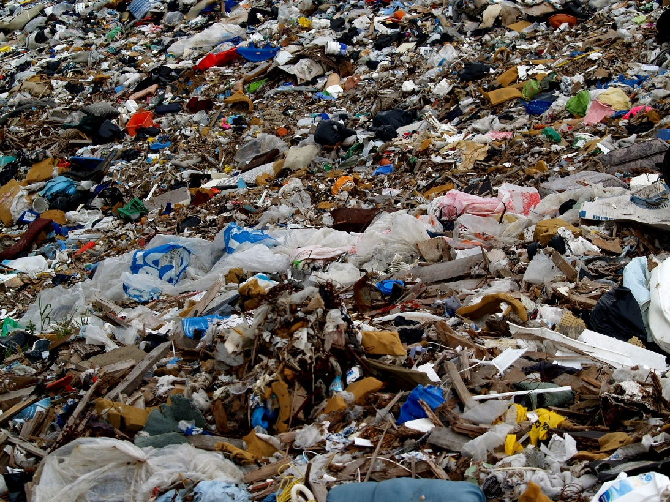
Project Cleanup

Slide 2
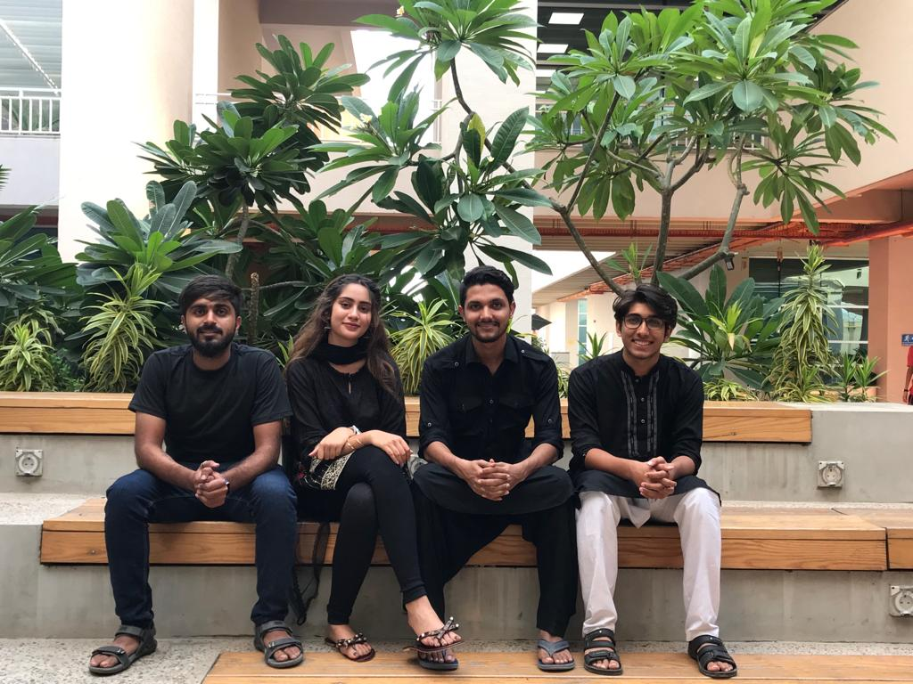
Team:
From Left to Right:
Ashhar Ayaz
Zoha Salani
Muhammad Tahir
Muhammad Ahsan Syed

Slide 3





Organization
Problem
Solution
System Diagram
Mockups/Dataset
Backlog and Task Divison
Question/Answers

Slide 4
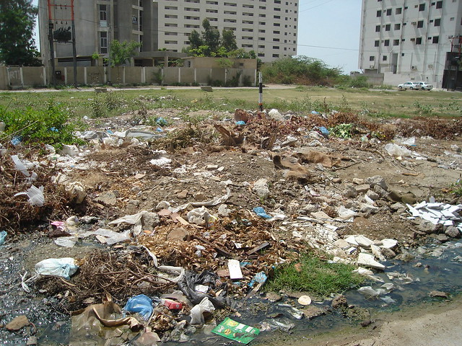
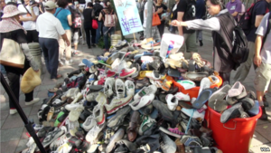
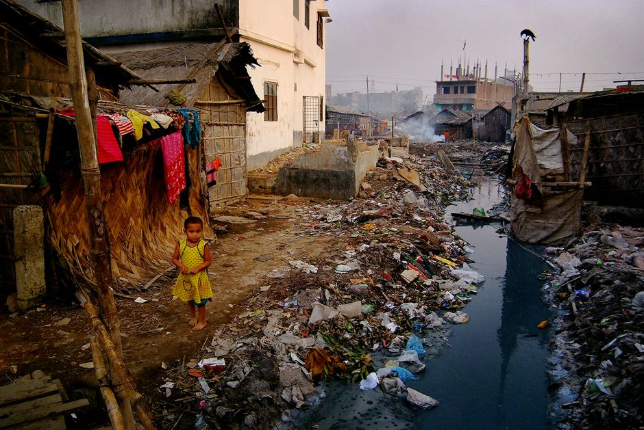
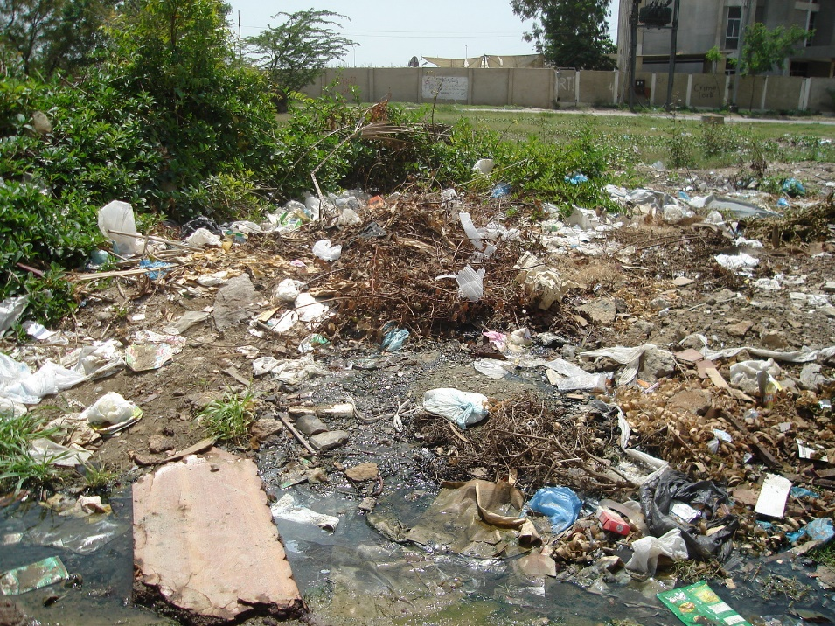
Recap:

Slide 5

Concerns:
Who will use app?
Can we send truck drivers?
Quantify recyclable garbage?

Slide 6
Literature Review:
Comparison and contrast to previous >= 5 works.
Explain the advantages and disadvantages of existing solutions comprehensively

Slide 7
Design:
ERD
UML
Model

Slide 8
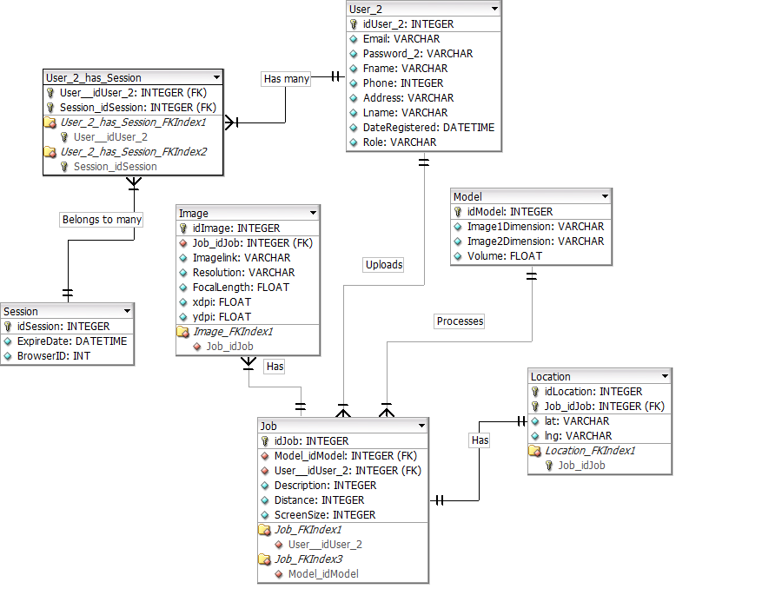

Slide 9
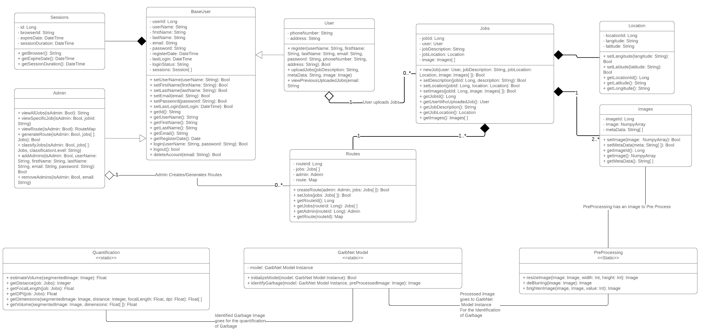

Slide 10
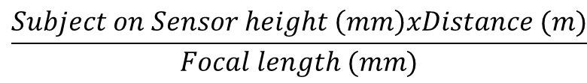
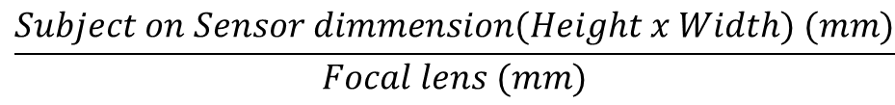

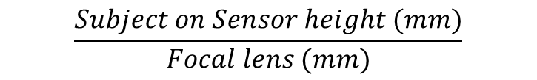
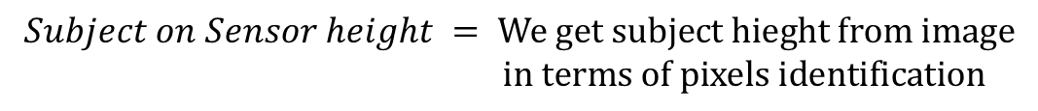
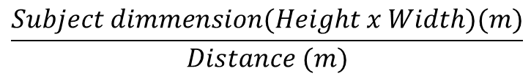
$$\frac{Subject dimmension(Height x Width)(m)}{Distance (m)}$$
=
$$\frac{Subject on Sensor dimmension(Height x Width) (mm)}{Focal lens (mm)}$$
$$\frac{Subject height (m)}{Distance (m)}$$
=
$$\frac{Subject on Sensor height (mm)}{Focal lens (mm)}$$
=
$$\frac{Subject on Sensor height \left(mm\right)xDistance (m)}{Focal length (mm)}$$
$$Subject height (m)$$
$$Focal Length = Can be obtained by camera$$
Approximate Distance $=Will be input by user in terms of steps$
$$Subject on Sensor height = We get subject hieght from image \\ in terms of pixels identification$$

Slide 12

Prototype:
User Application
Android based application
Web Application
Cloud Model
JavaScript based application
Python based ML model

Slide 13
Technical Challenges:
Described the technical challenges faced until now
How you resolved it or planning to resolve it
Very clear about future technical challenges and their resolution strategies

Slide 14

THANK YOU!

